Slide 1
SRP Implementation Success in a Complex Environment
Bryan L. Mack
Colorado Community College System
April 13, 2015
Session 11710

Slide 2
Session rules of etiquette
Please turn off your cell phone/pager unless your ringtone involves Chewbacca
If you’re going to take pictures of slides, please only do so of useful slides. Avoid slides 17, 23, 17, and 198
There really isn’t a 198th slide. I just put that in there to frighten you.
That being said – this presentation has a ton of material, so I am going to do my best to get through it – Please hold your questions until the end, I will make myself available afterwards in case we run out of time.
Thank you for your cooperation!

Slide 3
Introduction
Bryan L. Mack
Higher-Ed Employment History
Colorado School of Mines, Asst. Director of Advancement Services, 2002-2012
Colorado Community College System, Team Lead/Data Warehouse Developer, 2012-2015
Anything else you want or don’t want to know about me will be in various pictures throughout this presentation, with intentions of keeping you awake

Slide 4
Agenda

Slide 5
Goals / Basics / Hardware

Slide 6
Goals
Actually finish this presentation, there is a lot of content
Walk through the most common & useful set up, customization, and troubleshooting scenarios we found
Prevent people from falling asleep

Slide 7
What this Presentation Is Not
For end users (non-technical people) unless you want an appreciation for complexity
About Cognos setup
Heavy on MEP talk, though it will come up in some customization examples.
About snapshot stars; we will only be discussing operational stars & aggregate tables
Short

Slide 8

Basics
CCCS: 13 Schools (many with multiple campuses, all throughout Colorado) & a system office located in Denver
162K Current Students
B.I. Group: Director, Sr. DBA, Cognos Admin, 4 Developers
Oracle 11.2.0.4, LINUX Red Hat Enterprise Linux 5 Tikanga
ODS 8.4.1 – Oracle Streams - 2TB
EDW 8.4.3 – 90GB (without clean/input tables populated)

Slide 9
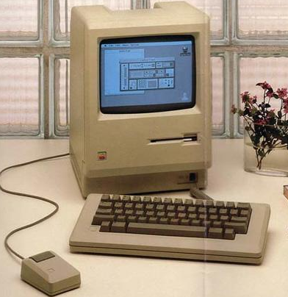
Pertinent Hardware Factoids
During Setup 24 Cores 94GB RAM EMC VNX5700 SAN
Very recent upgrades (mid-February, 2015) 32 Cores with Hyperthreading 252GB RAM EMC XtremIO (All-Flash Storage Array)

Slide 10
Overview of SRP

Slide 11
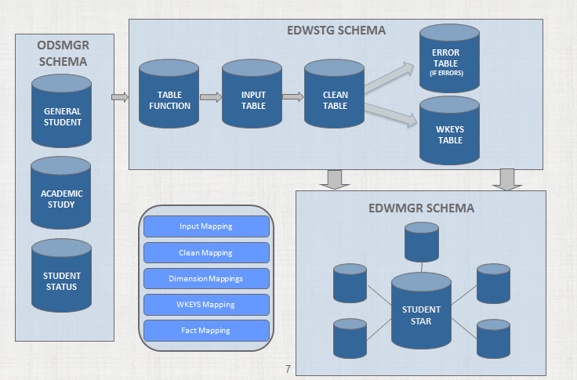
Data Flow

Slide 12
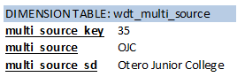
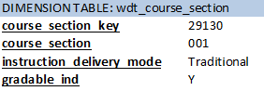
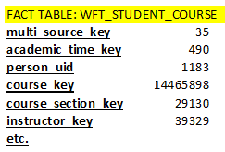
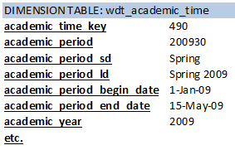
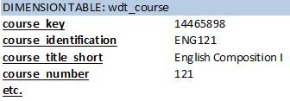
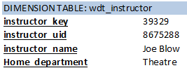
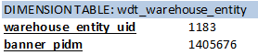
Star Schema Architecture – Student Course Star (partial)

Slide 13
Star Schema
Facts have all key values, no text strings. All joined by primary keys. Fact tables in EDW use the naming convention WFT_*
Dimensions have details about each attribute referenced in the fact tables. Dimensions in EDW use the naming convention WDT_*
Aggregate tables are massive fact tables pulling from many stars. These are the source of Cognos packages in SRP. Their naming convention is WAT_*
They join to dimensions in the already-existing operational stars
Note: WAZ_* tables are snapshots. CCCS is not yet using these, they will not be discussed in this presentation

Slide 14
EDW/SRP Architecture – Primary Schemas
EDWSTG
Extract Packages (Three primary: FinAid, General, Student)
Clean, Input, & WKeys OWB mapping packages
Change Tables
Input, Clean, WKeys, & Error tables for each star
EDWMGR
Fact, Dimension, Aggregate, & Freeze tables
OWB mapping packages for Fact, Dim, Agg, & Frz’s inserts

Slide 15
Input Tables
Stored in EDWSTG schema
Table name format WTT_*_INPUT
Populated at time a load or refresh is run, Truncated after fact loaded
Populated by table function (most of the time) within edwstg extract package. Ex: edw_student_extr.f_get_advisor

Slide 16
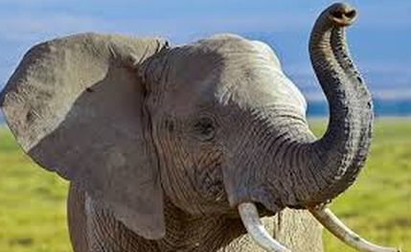
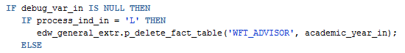
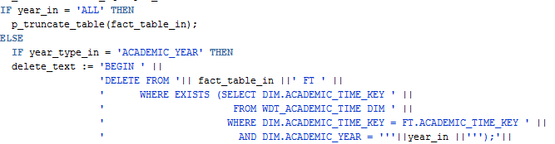
Input Tables
Can call table function to see what will populate to the input
Select * from table(edw_student_extr.f_get_advisor(‘2015’,’L’,sysdate,null));

Slide 17

Clean Tables
Stored in EDWSTG Schema
Table name format WTT_*_CLEAN
Populated during load or refresh after the input table is populated
Sourced from WTT_*_INPUT table
Uses cleansing rules you have set up (we will discuss this shortly) to put data in proper EDW format
Data from CLEAN table is used to load:
Dimension Tables
WKeys Table

Slide 18
Error Tables
Stored in EDWSTG Schema
Table name format WTT_*_ERROR
Holds values which do not pass through cleansing
Error table truncated next time you run a load/refresh of this star

Slide 19

WKeys Tables
Stored in EDWSTG Schema
Table name format WTT_*_WKEYS
Populated after dimensions loaded
Sourced from WTT_*_CLEAN table & dimension tables
from same star
Used to load fact tables
If you have patch p1-1d7fk0z applied, records that violate a PK will be moved to a work table (WKE_*)
These records can be input to the star if debug is run

Slide 20
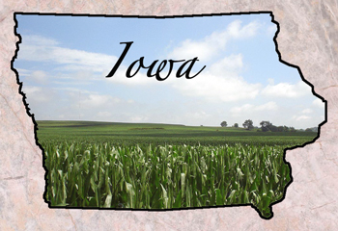

Some Random Things About me
I grew up in Carroll, Iowa I went to Iowa State We have lots of corn there University, Go Cyclones!!!

Slide 21
Initial Setup, Configuration, & Customizations

Slide 22
Setup, Configuration, and Customizations
Custom User Attributes In Dimensions
Cleansing Rules & Translations
Admin UI Prompts for Loads/Refreshes
MEP – Multi-Entity Processing

Slide 23
Custom User Attributes In Dimensions
Each Dimension can store up to 5 custom values
user_attribute_xx VARCHAR2(65) user_attribute_xx_sd VARCHAR2(255) user_attribute_xx_ld VARCHAR2(255)
Can store whatever you want in these values.
Let’s walk through an example we used in WDT_REGISTRATION

Slide 24
Custom User Attributes in Dimensions
CCCS uses a Countable/Not-Countable indicator, populated by a custom function, to determine if a course is counted towards FTE.
Function = zskfunc.f_calc_countable_stat(registration_status_in)
We have determined we need to store this value within WDT_REGISTRATION

Slide 25
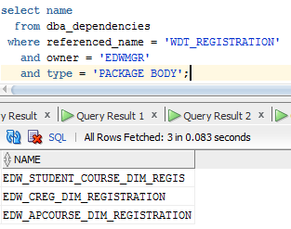
Custom User Attributes in Dimensions
Find which star(s) populate this dimension:
Find the extract packages which populate each of these:
Edw_creg_extr.f_get_course_registration
Edw_apcourse_extr.f_get_acad_prog_course
Edw_student_extr.f_get_student_course

Slide 26
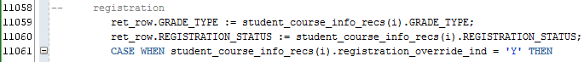
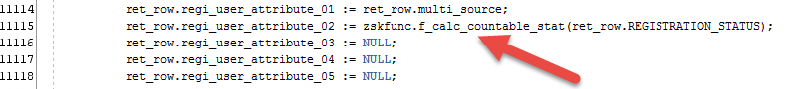
Custom User Attributes in Dimensions
Modify the code in the package that populates the dimension:
……….
………..

Slide 27
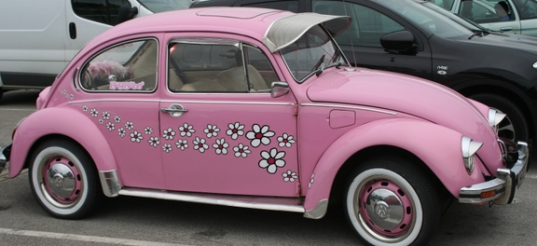
BUG ALERT!!!!
Ellucian CR-000114690
If you customize the student course star by adding user_attribute_01 or user_attribute02, be sure to modify the OWB mapping, else it will never join!

Slide 28
Cleansing Rules
You need to tell EDW which pieces of data are acceptable and how to display them.
Cleansing rules are stored in IA_ADMIN.MGRCDES
Can be input to the table via the Admin UI
Can add translations for pieces of data you may need to take on an alternative meaning

Slide 29
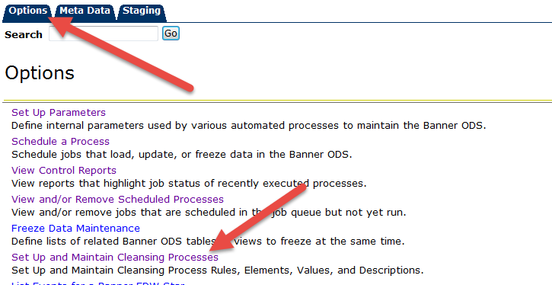
Create new cleansing rule via Admin UI tool

Slide 30
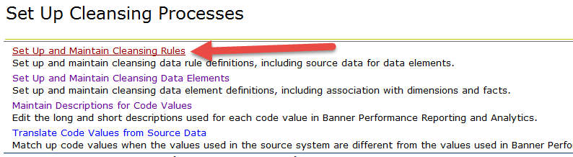
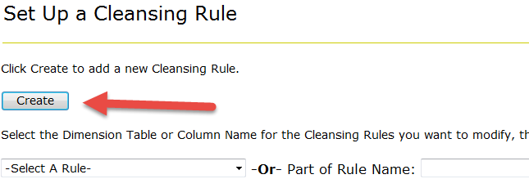
Create new cleansing rule via Admin UI tool

Slide 31
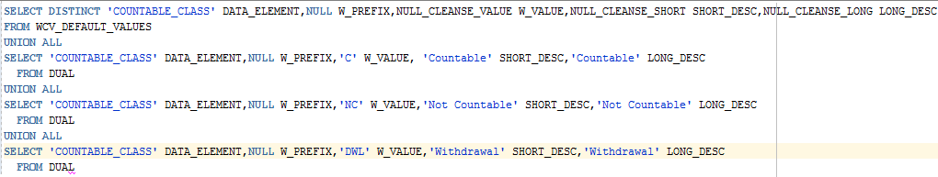
Create new cleansing rule via Admin UI tool
You need to write the SQL to pull the values that will be acceptable in the ODS. Need to populate these 5 fields:
**Do not put a semi-colon at the end, or Admin UI will spit this at you:

Slide 32
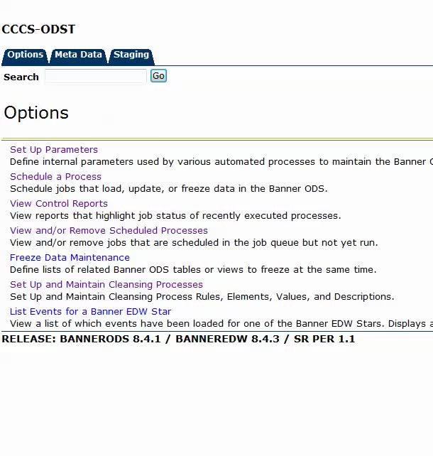
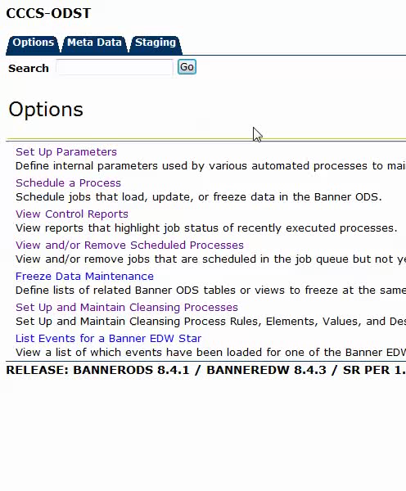
Assign cleansing rule to dimension value

Slide 33
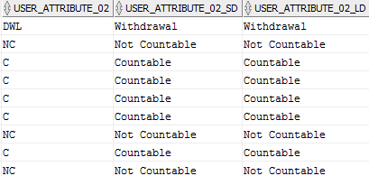
Done! Verify it worked
SELECT * FROM wdt_registration

Slide 34
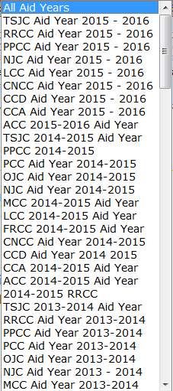
Custom Prompts for Loads/Refreshes
This is the Financial Aid prompt
All schools use the same value with different
Descriptions – so this is redundant.

Slide 35
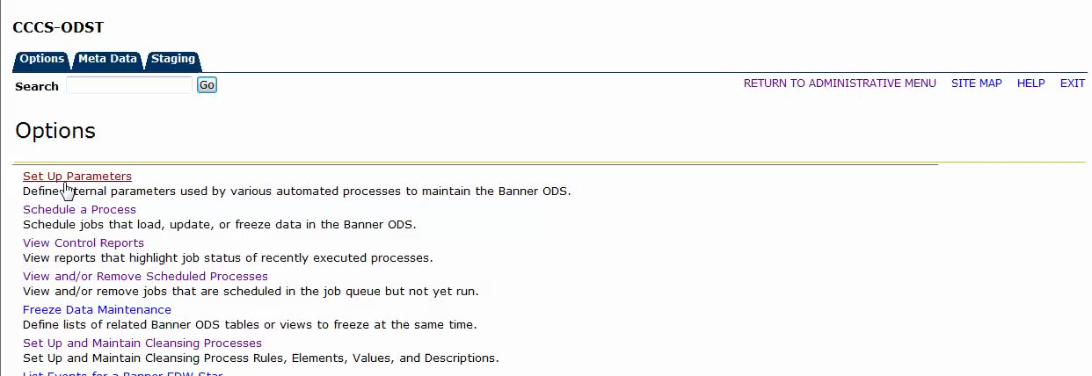
Custom Prompts for Loads/Refreshes

Slide 36
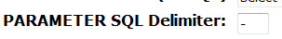
Custom Prompts for Loads/Refreshes
Modify the SQL to select what you want. Note that there is a bug here – if you have a hyphen in what your SQL returns, you cannot use the hyphen as the delimiter in Admin UI
Plug your custom SQL into the PARAMETER Value box:

Slide 37
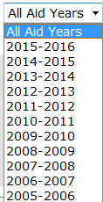
Custom Prompts for Loads/Refreshes
Voila!
is now….

Slide 38




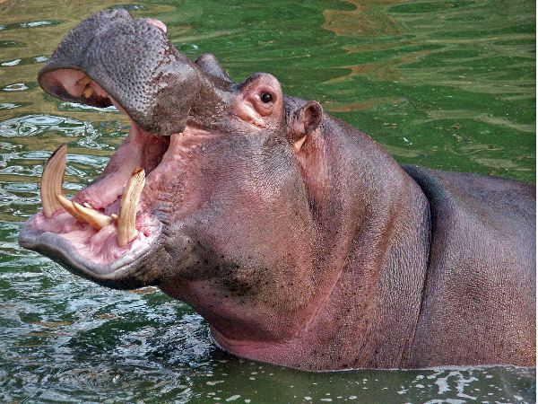


Random things I like – WAKE UP!!!

Slide 39
MEP
Multi-Entity Processing
We track 13 colleges & our system office’s data in a single database. There are many security features in place to assure that each school see’s only their own data.
BANNER_TABLE_VPDI = MULTI_SOURCE = MIF_VALUE

Slide 40
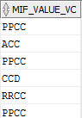
MEP – I’ll keep it high-level since few of you use it
Modify every extract package; put in MEP joins where applicable
Populate each dimension with the mif_value (user_attribute_01)
Modify OWB mappings to merge on user_attribute_01 as well
Custom cleansing values for user_attribute_01
Virtual column in fact table showing the MEP description
“Intentional Cartesian” on WDT_WAREHOUSE_ENTITY (customized OWB mapping)
same done to many entire stars (test, hold, race, etc.)
Remove nvl(mif_value,’CCCS’) references in extract packages
This prevented our indexes from being used in loads/refreshes

Slide 41
Loading Data

Slide 42
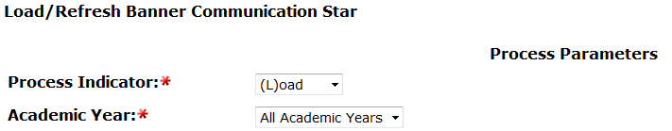
Loading Data
Unlike ODS, in EDW the Admin UI jobs are a single job per star. You specify with an input parameter whether it’s a Load or Refresh.
Some stars you can load year by year: (student, student course, etc.)
Some stars have to be loaded in the entirety
(hold, test, race, banner communication*, etc.)

Slide 43
Common Data Load Errors & Warnings
ORA-00054: resource busy and acquire with NOWAIT specified or timeout expired
ORA-01427: single-row subquery returns more than one row
** Data Element <<whatever name>> needs a rule defined for <<whatever value>>
ERROR: Primary Key constraint <name> was violated while loading table: <table name>

Slide 44
Common Errors
ORA-00054: resource busy and acquire with NOWAIT specified or timeout expired
You probably are running stars that are trying to populate the same dimension at the same time. Most stars update at least some of the same dimensions (wdt_person, wdt_demographic, wdt_multi_source are common offenders)
Simply wait for one star to finish before you load another
(or use a wide-load, but there are implications, we will discuss in a bit)

Slide 45
Common Errors
ORA-01427: single-row subquery returns more than one row
For CCCS, this was a MEP issue. We were trying to join records, but a student would have a record at multiple schools. Haven’t had this happen since our EDW was converted to be fully MEP.
If you are a MEP client, I see no way around this error other than to Carteisan WDT_WAREHOUSE_ENTITY with a MIF value for every option in WDT_MULTI_SOURCE.

Slide 46
Common Errors
** Data Element <<whatever name>> needs a rule defined for <<whatever value>> **
You have a cleansing error. Either assign the proper cleansing rule to the value (as we discussed in the user_attribute customization portion), or set up a cleansing translation.
Note: many times this can be resolved by simply re-running LOAD_DIM_CLEANSING, as your users have simply added a new value to the database.

Slide 47
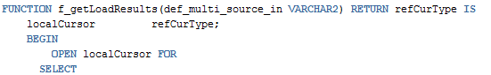
Cleansing Translation
In our test environment – this value kept showing up with a cleansing warning:
Find the table function in edw_general_extr:
…… what is the ODS source of this table function?
…….
Ok – let’s check out the ODS data…..

Slide 48
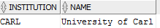
Cleansing translation
select * from mst_institution where institution = 'CARL';
In this case, it was our test database, and a guy named Carl who works in our office built a school to play with. Regardless, in any circumstance, you can make up a translation in case this value of ‘CARL’ does not have a subsequent record in STVSBGI.
To set up a translation in Admin UI
Options -> Set Up and Maintain Cleansing Processes -> Translate Code Values from Source Data

Slide 49
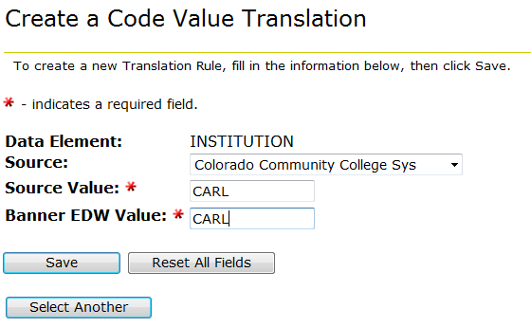
Cleansing Translation
You are circumventing the need for a STVSBGI record

Slide 50
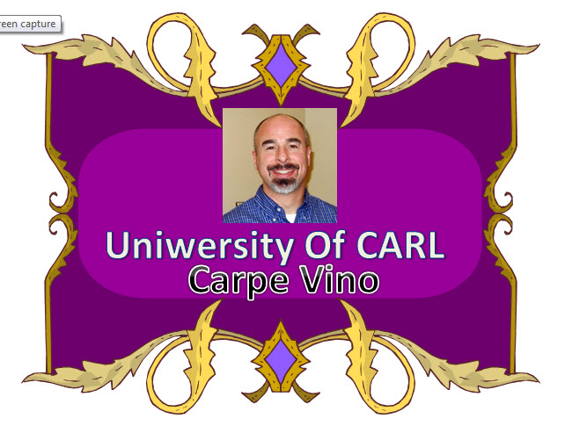
Taunting
Always be sure to taunt the person who made up such a silly thing as the “University of Carl”
At CCCS, we apparently can’t
Spell “University” properly.

Slide 51
Common Errors
ERROR: Primary Key constraint <name> was violated while loading table: <table name>
You likely have bad Banner data
Find the bad data
Get it cleaned up
Develop a QA report so it is fixed as it happens moving forward

Slide 52
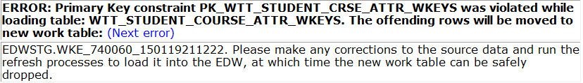
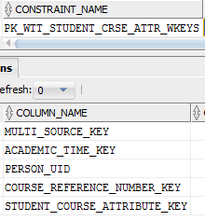
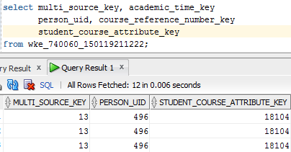
Constraint Error Example
What was the primary key that was violated?
Query the error table for the keys that make up the constraint:

Slide 53
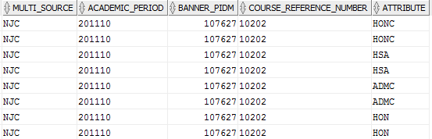
Join Error keys to Dimensions to see “real” data
select ms.multi_source, at.academic_period, we.banner_pidm, crn.course_reference_number, att.attribute
from wke_740060_150119211222 srp,
wdt_multi_source ms,
wdt_academic_time at,
wdt_course_reference_number crn,
wdt_attribute att,
wdt_warehouse_entity we
where srp.multi_source_key = ms.multi_source_key
and srp.academic_time_key = at.academic_time_key
and srp.course_reference_number_key = crn.course_reference_number_key
and srp.person_uid = we.warehouse_entity_uid
and srp.student_course_attribute_key = att.attribute_key

Slide 54
Constraint Error Example
Bottom line: track the data back to Banner and have someone clean up the duplicate entries.
Find the dups in ODS by way of their source, referenced within the EDW extract package
Find the source of that ODS table in Banner
Send that Banner area’s duplicate data to the proper people to get it cleaned up

Slide 55
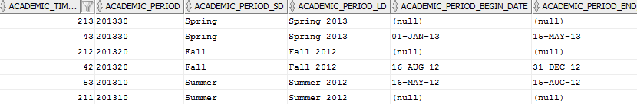
Caveat #1 – Make sure ODS fully loaded
We ran a load of the Course Instructor star when mgt_year_type_definition was empty. Didn’t expect it to harm anything since wdt_academic_time was already populated.
The academic period itself comes from mst_instructional_assignment. The begin & end dates come from mgt_year_type_definition (with an outer join).
The result – a duplicate row for each academic period.

Slide 56
Caveat #2 – Student Cohort Star + End of Time
CCCS uses end_of-time (date = ‘999999’,’YYYYMMDD’) for most records in mst_student_cohort.academic_period_end
If an academic period lies between academic_period_start & academic_period_end, a student cohort record will be created in EDW, regardless of the student’s enrollment status. In this case, all terms fall between 200910 and 999999, so a record for every term in the year for which you run the load will be created

Slide 57
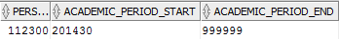
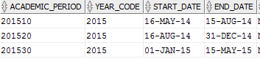
Caveat #2 – Student Cohort Star + End of Time
Sole record for this person in MST_STUDENT_COHORT
Student Cohort star calls fill_academic_period function, which fills in which terms to create EDW rows for. The code is essentially this:
Select <stuff> FROM MGT_YEAR_TYPE_DEFINITION Y
WHERE (‘2014’ = 'ALL' or Y.YEAR_CODE = ‘2014’) AND Y.ACADEMIC_PERIOD BETWEEN ‘201430’ AND ‘999999’
If I run the star for 2015, even though the student did not enroll in 2015, we get these rows inserted:

Slide 58
Caveat #3 – Test Star not easily customizable
CCCS Uses Accuplacer tests; not simple to customize
Hard-coded test names exist everywhere.
Input/Clean/Wkeys tables
Cognos packages
Aggregate Tables
To customize, you would have to either educate users that “TOEFL HIGH SCORE” really means “ACCUPLACER MATH SCORE”, or change field names everywhere. We are choosing to simply not use this area for now.

Slide 59
Refreshing Data

Slide 60
Refreshing SRP Data
CCCS’ Goal: Run refresh nightly. Note that this must be done after the ODS refreshes have successfully run, and they must complete by an acceptable time.
How long did the refresh for SRP take the first time we ran it – guesses??

Slide 61

52 Hours. Fifty Two Hours. Two Days + 4 hours.

Slide 62
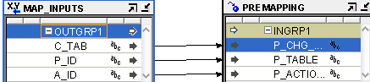
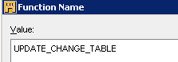
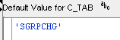
Change Table Process
Star refreshes use CHG_* change table, populated during ODS mappings as a OWB pre-mapping process.
DELETE_MST_ADVISOR OWB Mapping:
So the mapping is calling UPDATE_CHANGE_TABLE proc (in ODSMGR), which calls
ODSMGR.MAINTAIN_EDW_CHANGE_RECORDS for SPRPCHG

Slide 63
ODSMGR.MAINTAIN_EDW_CHANGE_RECORDS proc
This will populate many change tables. For this case, we will just look at CHG_ADVISOR:
Delivered:
EXECUTE IMMEDIATE(f_prepare_sql('CHG_ADVISOR', 'edw_chg.PERSON_UID = src.SPRPCHG_PIDM) AND src.SPRPCHG_PROCESS_ID = ''', 'src.SPRPCHG_PIDM, '''|| p_chg_table || ''', SYSDATE'));
Custom:
EXECUTE IMMEDIATE(f_prepare_sql('CHG_ADVISOR', 'edw_chg.PERSON_UID = src.SPRPCHG_PIDM) AND src.SPRPCHG_TABLE_NAME IN (''ADVISOR'',''MST_RACE'',''PERSON'',''MEDICAL_INFORMATION'',''VISA'',''GENERAL_STUDENT'') AND src.SPRPCHG_PROCESS_ID = ''', 'src.SPRPCHG_PIDM, '''|| p_chg_table || ''', SYSDATE'));
We’ll about the customization shortly.

Slide 64
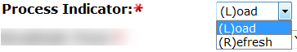
Change Table Process
Everything in SPRPCHG (the change table that MST_ADVISOR uses), gets inserted to CHG_ADVISOR.
The LOAD mappings in AdminUI have an indicator that you flip to “R” to run it as a refresh.
Extract packages have separate table functions for Refresh that differ from “Load” table functions in that they join to the CHG_* table on the PIDM.

Slide 65
Refreshing Data Methods
Run Serially (the approach which took 52 hours)
Star by Star
Custom Oracle Chains job (CCCS custom build)
Wide Refreshes
Runs all Inputs & Cleans at once (kind of)
Runs Dimensions star-by-star
Runs all Wkeys & Fact inserts at once (kind of)
Hybrid of Wide Refreshes + Oracle Chains
Spoiler Alert: This is what we used

Slide 66
Serial Refreshes
Refresh Stars One At a Time
Cannot run two stars simultaneously if they update any of the same dimensions, which they nearly always do. If two stars try to load the same dimension at the same time, there will be contention:

Slide 67
Serial Refresh Options
1) Build Admin UI Job
Can be time-consuming building a custom job with 30 steps (depending on how many stars you use), but you want these to kick off immediately after one-another
2) Oracle Chains
Use Oracle chains by way of Admin UI
We are presenting on how to do this tomorrow

Slide 68
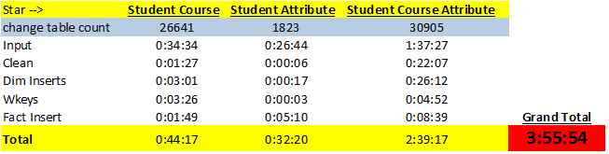
Serial Refreshes
In this example, the total time to refresh these 3 stars is 3:55:54. Running serially is simply the sum of all these the times across the 3 stars.
Based on the amount of Change Table records we get at CCCS, running serially is not an option.

Slide 69
Wide Refreshes
Wide Refreshes perform loads in parallel
Run all input table & clean mappings simultaneously
Run dimensions in a hybrid of parallel & serial
The sets of dimensions for a star are run star-by-star
All dimensions for a single star run at the same time
Run Wkeys & Fact Inserts for all stars simultaneously

Slide 70
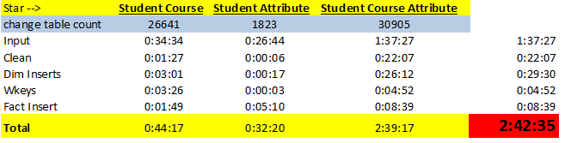
Wide Refreshes
Add only the longest running input, clean, wkeys, and fact insert time
Add all of the dimension inserts
This is your new total (your hardware makes this an inexact science, but you get the idea)
We just saved 1:15 simply by using wide refreshes

Slide 71
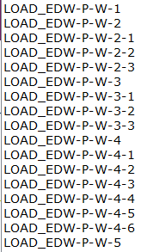
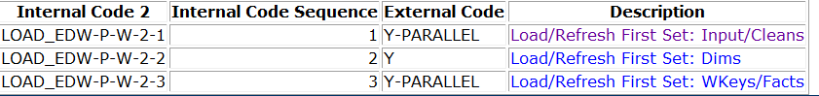

Configuring Wide Refreshes
AdminUI -> Options -> Set Up Parameters
Internal Group = ETL Control Group Internal Codes -------------------------------------→
Turn each mapping on/off via External Code

Slide 72
Wide Refresh Caveat
You must have enough tablespace to hold the tables for all of the following for 20+ stars simultaneously:
WTT_*_INPUT
WTT_*_CLEAN WTT_*_WKEYS
These can suck up major space, really fast. For example, our WTT_CLEAN table alone will eat up 160GB.
These tables all truncate after the fact table inserts.

Slide 73
CCCS Custom Tuning
Add Parallel hints to OWB mappings
Custom Indexes (removed NVL from MEP’d tables)
Additional custom indexes where needed
Convert BMIs to BTREE indexes on Fact tables
Limit refresh records to >= 2009
Custom views/mviews
Tune change tables
Identify bad nightly processes
Customize MAINTAIN_EDW_CHANGE_TABLES
Customize student course change table

Slide 74
Convert BMIs to BTREE indexes on Facts
Create B-Tree index on person_uid
Improves delete time during refresh
CCCS had no noticeable query performance degradation
Use custom name for index (CCCS_WFT_TEXT_INDEX_02)
Be sure to update MGBINDX for the BMI you removed
UPDATE mgbindx SET mgbindx_indextype = ' ' WHERE mgbindx_indexname = 'WFT_TEST_INDEX_02'

Slide 75
Limit Refresh Records to 2009 and greater
CCCS only uses the EDW for data more recent than 2009
When running a refresh, you will get data for all terms; there is no restriction on the year.
We modified each refresh table function’s logic within the extract package with an additional predicate statement which varies across stars. Examples:
and a.academic_period_graduation >= '200910‘
And a.academic_year >= '2009‘
We also eliminated continuing ed terms so refreshes wouldn’t load them. These terms start with “8” at CCCS
and substr(a.academic_period_start,1,1) <> '8'

Slide 76
Custom Views/MViews
Extract packages often reference WCV_EXTR_PERSON_DETAILS. This view takes a while to populate due to address info. We made a custom version that is identical that pulls in no addresses (CCCS_EXTR_PERSON_DETS_NO_ADDY)
We materialize two other views which were causing slow run times. These are materialized nightly after the ODS refresh, but before the EDW refresh
Cccs_wcv_extr_person_detls_mv (for when we do need addresses)
Cccs_wcv_extr_stud_classif_mv
Change references to these views in all extract packages

Slide 77
Tune Change Tables – Bad Nightly Processes
Some of our change tables routinely had enormous numbers
175K nightly change records were being made by a job sub that was no longer needed. Even when the job was still needed, it changed the activity_date on each record, which would cause a change record to be unnecessarily populated.
Clean Address process run nightly was cleaning all records entered/changed in the last 1059 days. This was the default value set by our vendor. It was cleaning the same addresses night after night for a three years.
SPRPCHG counts before the change: 303K nightly address records
SPRPCHG counts after the change : <100 nightly address records

Slide 78
Tune Change Tables - Customize MAINTAIN_EDW_CHANGE_RECORDS
This ODSMGR proc selects all records from the ODS change table into the Star’s change table, regardless if it needs them.
Example: CHG_CONTACT. 544K nightly change records (before we fixed the bad jobs I previously discussed)
Look in maintain_edw_change_records for the change table source. This is the only one, found under SPRPCHG:
We can deduct that the Contact star deletes & inserts every record in SPRPCHG nightly – but does it need to?

Slide 79

Tune Change Tables - Customize MAINTAIN_EDW_CHANGE_RECORDS
Identify source tables of the Contact Star by looking at the extract package
Now identify the Banner sources of everything that make up these views/tables. (browse the source code in ODSSRC)
Check the triggers on all those Banner tables and see what it populates in the change table
In this case – we found these ODS objects are really only affected by records in SPRPCHG where the sprpchg_table_name IN
(''CONTACT'',''PRE_STUDENT'',''MST_RACE'',''PERSON'',''MEDICAL_INFORMATION'',''VIS A'',''GENERAL_STUDENT'')

Slide 80
Tune Change Tables - Customize MAINTAIN_EDW_CHANGE_RECORDS
Change this:
EXECUTE IMMEDIATE(f_prepare_sql('CHG_CONTACT', 'edw_chg.PERSON_UID = src.SPRPCHG_PIDM) AND src.SPRPCHG_PROCESS_ID = ''', 'src.SPRPCHG_PIDM, '''|| p_chg_table || ''', SYSDATE'));
To This:
EXECUTE IMMEDIATE(f_prepare_sql('CHG_CONTACT', 'edw_chg.PERSON_UID = src.SPRPCHG_PIDM) and src.sprpchg_process_id in (''CONTACT'',''PRE_STUDENT'',''MST_RACE'',''PERSON'',''MEDICAL_INFORMATION'',''VISA'',''GENERAL_STUDENT'') AND src.SPRPCHG_PROCESS_ID = ''', 'src.SPRPCHG_PIDM, '''|| p_chg_table || ''', SYSDATE'));
Change Count Before: 544,144, Change Count After: 969
We did this to each of our stars – our refresh time is getting better!

Slide 81
Student Course Change Table Customization
This refresh alone was taking 3 hours nightly after all the tuning we’ve done. We discovered that the change table only contains the CRN. At CCCS, that CRN can be used at 13 different schools, and in multiple terms – the key is CRN + MULTI_SOURCE + ACADEMIC_PERIOD
We decided to add the academic_period to the change table (CHG_STUDENT_COURSE) so it will only remove the CRN from the period where the change was made

Slide 82
Modifying CHG_STUDENT_COURSE
Add academic_period field to CHG_STUDENT_COURSE
Modify MAINTAIN_EDW_CHANGE_RECORDS
FROM: edw_chg.COURSE_REFERENCE_NUMBER = src.SSROCHG_CRN TO: edw_chg.COURSE_REFERENCE_NUMBER = src.SSROCHG_CRN and edw_chg.academic_period = src.ssrochg_term_code
Modify the change table condition in edw_student_extr.f_get_student_course to join on academic period
Modify EDWSTG.EDW_GENERAL_EXTR.p_insert_student_crse_chg_rec
Add “academic_period” to the list of values to insert on both sides of the UNION
Modify EDWSTG.MAINTAIN_EDW_ERROR_RECORDS proc
Add condition to CASE block for CHG_STUDENT_COURSE to join on academic_period
Modify EDW_GENERAL_EXTR.p_delete_fact_records
Add condition to CASE block for CHG_STUDENT_COURSE to join on academic_period

Slide 83
Customization
Control reports do not display the number of deletes or inserts on refreshes:
Our DBA built in counts before & after the delete so we could see:
Hopefully you can do math

Slide 84

Wake up! We’re almost done!

Slide 85
Last one – Student Progress Aggregate Refresh
The change table never populated with records (this change table is special – it uses a proc in edw_etl_util package to populate)
Subsequently, student_engagement_aggregate will not populate the changes as it pulls everything from student_progress_aggregate
Remove reference to ALL_IV_XFORM_MAP_PARAMETERS C
That is being removed in the next version of baseline

Slide 86

Student Progress Aggregate Refresh
Missing MEP join in OWB mapping Joiner (if you are a MEP client and you Cartesian WDT_WAREHOUSE_ENTITY)
Create Unique index on person_uid on chg_student_progress
Index on wat_student_progress.person_uid
Nologging on aggregate table

Slide 87

Our Current Refresh time of SRP
We chopped off nearly 50 hours from our refresh time using a combination of these tuning methods. Our EDW went live in early January, 2015.

Slide 88

Sorry, that was a lot of content. The End.

Slide 89
Questions & Answers

Slide 90
Thank you!
Bryan L. Mack
bryan.mack@cccs.edu
Please complete the online session evaluation form.
Session ID 11710

